Slide 1
Lesson 4 - Modules, Packages & Libraries
Mack 2021

Slide 2
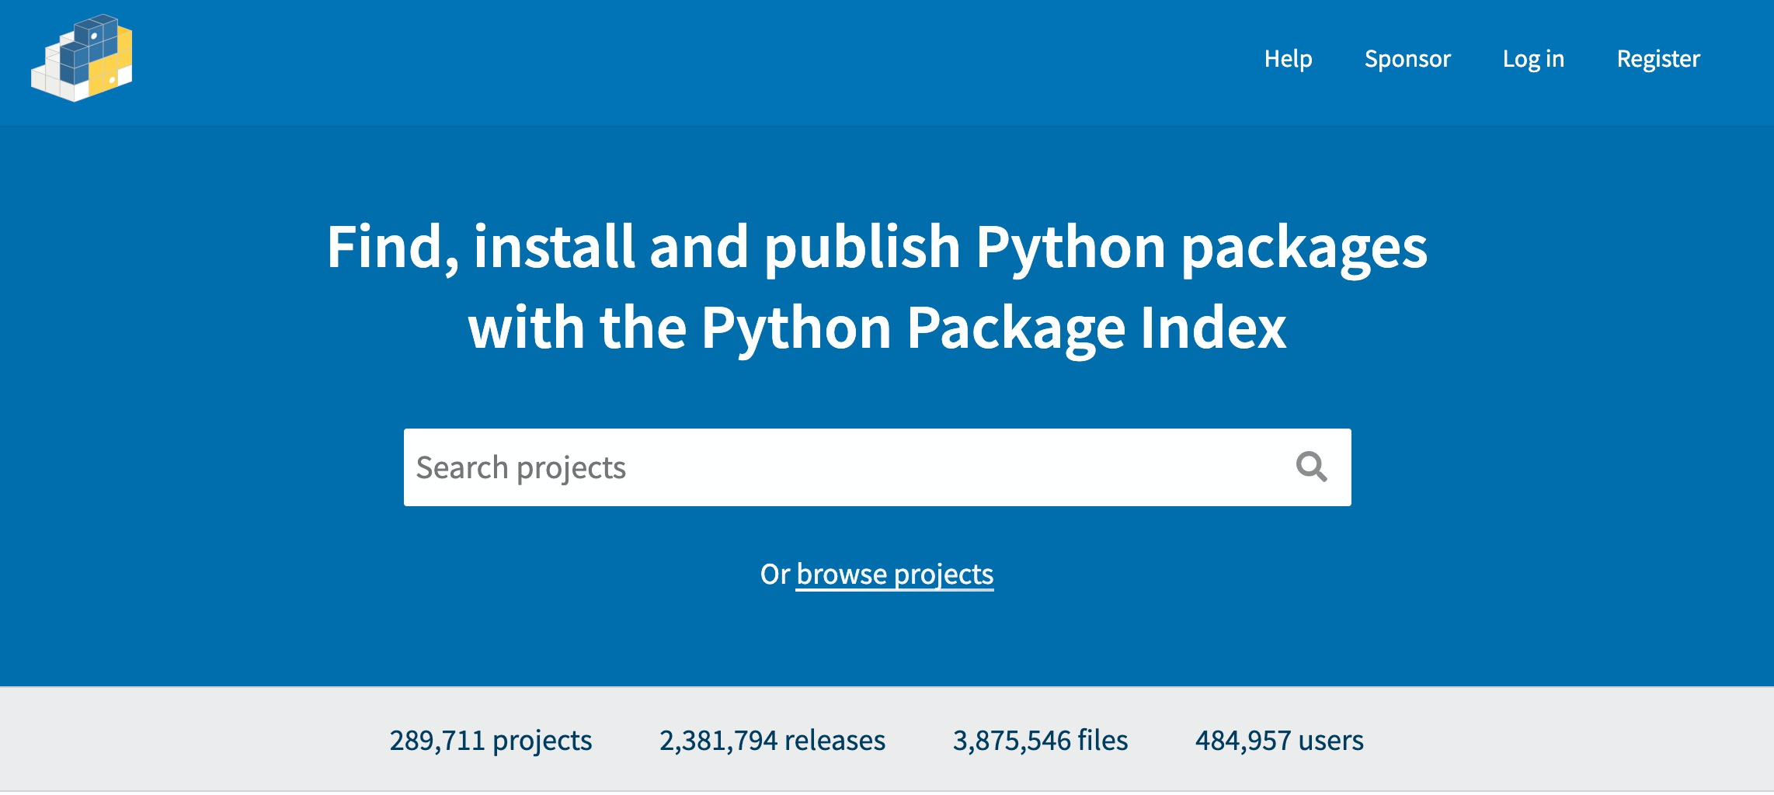
Python as Open-Source
Source: https://pypi.org/
Notes:
Python is an open-source language. What this means is that python’s source code is shared and available for anybody to access, make a copy and modify. This allows users in the python community to develop modules, packages and libraries that everyone can incorporate into their code and use.

Slide 3
Modules, Packages & Libraries
A python module:
can be imported into your code.
contains predefined functions, variables and more.
helps to build programs faster and with less difficulty.
print(average(2, 5))
Traceback (most recent call last):
File "main.py", line 16, in <module>
print(average(2, 5))
NameError: name 'average' is not defined
Notes:
A module in python is full of pre-built functions, variables and more and is meant to be imported and used within your code. Let’s say that you wanted to find the average of two numbers. We could try typing this, but would end up with an error. This is because there is no function for average built in to Python. Let’s build the function for the average of two number.

Slide 4
Modules, Packages & Libraries
A python module:
can be imported into your code.
contains predefined functions, variables and more.
helps to build programs faster and with less difficulty.
def average(a, b):
return(a + b)/2
print(average(2, 5))
3.5
Notes:
To find the average of two numbers, we would add the numbers and then divide by 2. Here is a function that will return the average. Now, if we try to find the average, it will work. Instead of defining this function in every exercise we complete, instead we could import a module that already has this function defined and use that. This can help save a lot of time when more complex functions are needed.

Slide 5
Modules, Packages & Libraries
A python module:
can be imported into your code.
contains predefined functions, variables and more.
helps to build programs faster and with less difficulty.
import module
print(average(2, 5))
3.5
module.py
def average(a, b):
return(a + b)/2
Notes:
Instead of defining this function in every exercise we complete, instead we could import a module that already has this function defined and use that. By importing the module, our file now includes all of the functions that are defined within the module. This can help save a lot of time when more complex functions are needed.

Slide 6
Modules, Packages & Libraries
A python module:
can be imported into your code.
contains predefined functions, variables and more.
helps to build programs faster and with less difficulty.
A package is a collection of related modules.
A library is a collection of modules and packages.
Notes:
Two other terms used are a package - which is a collection of different modules and a library which is a much bigger collection of other packages, modules and functions. Modules, packages and libraries are all available to python users to use within their code, their projects and their programs.

Slide 7
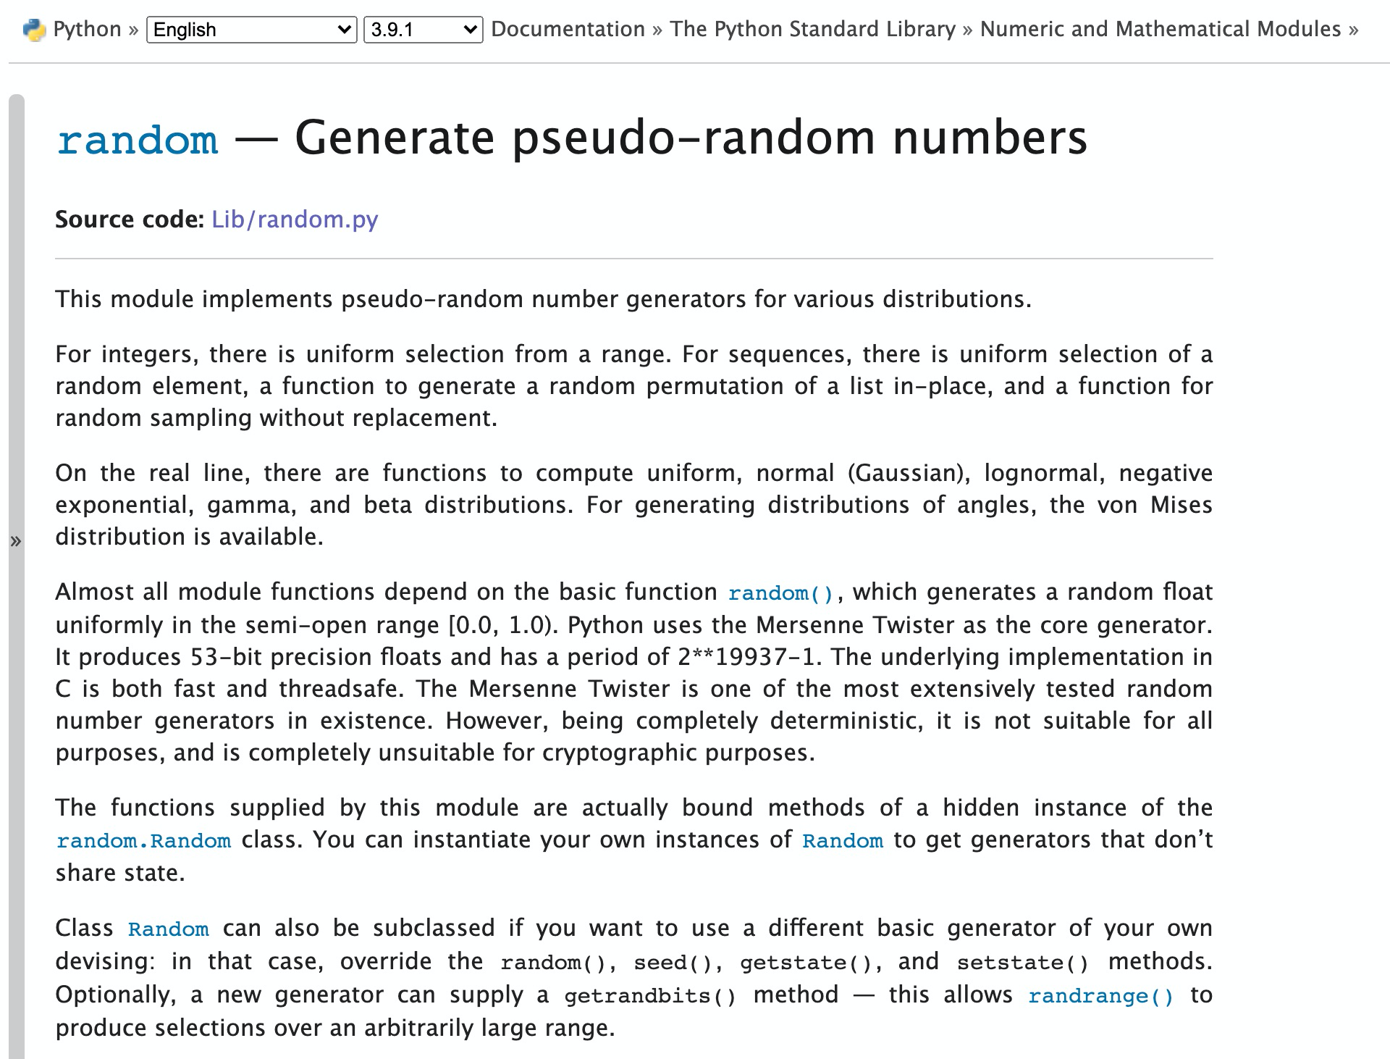
Documentation
Documentation is a written set of instructions for using the python module or library.
Lists functions that are included
Directs how to use each function
Offers examples
Notes:
When using any module or library, it’s important to know how to find and use the documentation that was written for that specific library. The documentation will tell you what functions, methods and variables are available that you can use, how to use them and will often give you some examples of the functions being used as well. This can be very helpful in learning how to best use each module or library. Shown here is the documentation for the random library. If we scroll a bit further down,

Slide 8
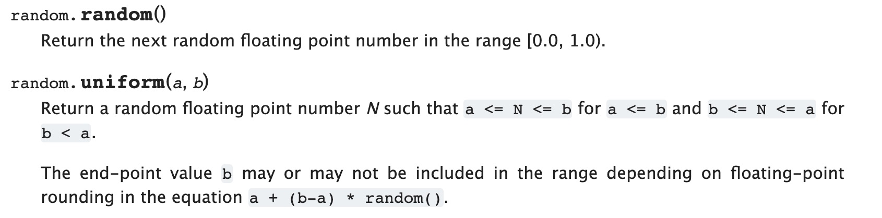
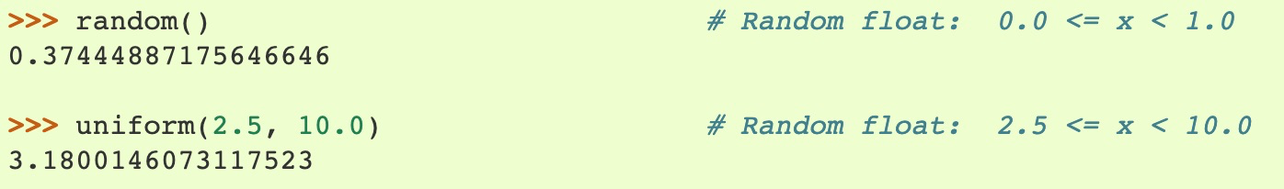
Documentation
Notes:
By checking the documentation, we see that we can not only return a random float value from 0 to 1, which we did in our example, but there is also an option to return a float within a range of floats values using the function random.uniform. The two examples here are given in the documentation as well. The first example shows the random.random function, which returns a float from 0-1 and the second one demonstrates the random.uniform function which will, in this case, return a random float value between 2.5 and 10.

Slide 9





Libraries for Data Science
Notes:
There are a lot of data science specific libraries that are built for the python programming language. It’s one of the reasons that python is a very popular choice of language to use for data science. Each library is built for a different main purpose.

Slide 10
Libraries for Data Science
Notes:
We will be using pandas in this course, which was built off of the numpy library. Numpy is really good for working with arrays or lists and pandas adds on the functionality for data manipulation, analysis and visualization.

Slide 11
Libraries for Data Science
Notes:
Both matplotlib and seaborn provide functions and methods that can be used to create amazing data visualizations.

Slide 12
Libraries for Data Science
Notes:
And Scikit learn is mainly used for predictive data analysis which is used in machine learning and artificial intelligence.

Slide 13
Lesson Vocabulary
Term | Definition
module | A file containing Python definitions and statements.
package | A collection of related modules.
library | A collection of modules and packages.
documentation | Written instructions detailing the functions, methods, and variables available and how to use them.

Slide 14
A Python file that contains variables and functions and can be used in other programs is called a _________________.
Notes:
🍐 This is a Pear Deck Multiple Choice Slide. Your current options are: A: class, B: documentation, C: library, D: module,
🍐 To edit the type of question or choices, go back to the "Ask Students a Question" in the Pear Deck sidebar.

Slide 15
A collection of modules and packages that can be imported into a program is called a __________.
Notes:
🍐 This is a Pear Deck Multiple Choice Slide. Your current options are: A: class, B: documentation, C: library, D: function,
🍐 To edit the type of question or choices, go back to the "Ask Students a Question" in the Pear Deck sidebar.

Slide 16
How could you use the sqrt function from the math module to print the square root of 16?
import sqrt
print(math.sqrt(16))
from math import sqrt
print(math.sqrt(16))
from math import sqrt
print(sqrt(16))
import sqrt
print(sqrt(16))
Notes:
🍐 This is a Pear Deck Text Slide
🍐 To edit the type of question, go back to the "Ask Students a Question" in the Pear Deck sidebar.

